Slide 1

Interactive Animations and Games
Lesson 2
Plotting Shapes
Notes:
Lesson Plan: https://studio.code.org/s/csd3-2023/lessons/2

Slide 2
Teacher Resources
For Teachers!
Lesson Overview
The primary purpose of this lesson is to introduce students to the coordinate system they will use in Game Lab. Students begin by exploring the challenges of communicating how to draw with shapes and then transition to using a tool that introduces how this problem is approached in Game Lab. The warm-up activity quickly demonstrates the challenges of communicating position without some shared reference point. In the main activity, students explore a Game Lab tool that allows students to interactively place shapes on Game Lab's 400 by 400 grid. They then take turns instructing a partner how to draw a hidden image using this tool, accounting for many challenges students will encounter when programming in Game Lab. Students optionally create their own images to communicate before a final debrief discussion.
More guidance and resources for this lesson are available in the Lesson Plan:
https://studio.code.org/s/csd3-2023/lessons/2

Slide 3


Slide 4

Interactive Animations and Games Lesson 2 - Warm Up
Drawing Challenge
Two volunteers sit at the front of the room and
DON’T look at the screen.
Everyone else looks at a picture and
explains how to draw it.
What makes this challenging?

Slide 5
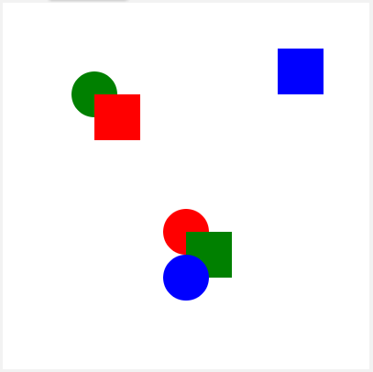
Interactive Animations and Games Lesson 2 - Warm Up
Drawing Challenge

Slide 6
Interactive Animations and Games Lesson 2 - Warm Up
Journal Prompt:
What are the different "challenges" or problems we're going to need to solve in order to successfully communicate these kinds of drawings?

Slide 7
Interactive Animations and Games Lesson 2 - Warm Up
Question of the Day
How can we clearly communicate how to draw something on a screen?

Slide 8


Slide 9

Interactive Animations and Games Lesson 2 - Activity
Code Studio, Level 1
Do This
Press “Run” to start the program.
With your partner, explore the tool.
What are some tips for someone using this tool?

Slide 10
Interactive Animations and Games Lesson 2 - Activity
Plotting Shapes Activity
You each have two different sets of pictures to describe to your partner. Take turns describing the pictures for your partner to draw on the screen.
Describer: Describe the drawing in detail, but do not look at the computer screen!
Drawer: Listen carefully to the instructions, but do not look at the paper!

Slide 11


Slide 12

Interactive Animations and Games Lesson 2 - Wrap Up
Journal:
What things were important in communicating about position, color, and order of the shapes in this activity?
What's a way you have seen similar problems solved in the past?

Slide 13
Interactive Animations and Games Lesson 2 - Wrap Up
Question of the Day
How can we clearly communicate how to draw something on a screen?

